Slide 1
Indian restaurants in the city of New York
By Mukesh Kumar

Slide 2
Introduction
New York City’s demographics show that it is a large and ethnically diverse metropolis. It is the largest city in the United States with a long history of international immigration.
Throughout its history, New York City has been a major point of entry for immigrants; the term “melting pot” was coined to describe densely populated immigrant neighborhoods on the Lower East Side.
With it’s diverse culture , comes diverse food items. There are many restaurants in New York City, each belonging to different categories like Chinese , Indian , French etc.

Slide 3
Business Problem
A restaurant is a business which prepares and serves food and drink to customers in return for money, either paid before the meal, after the meal, or with an open account. The City of New York is famous for its excellent cuisine. So, it is evident that to survive in such competitive market it is very important to strategically plan.

Slide 4
Factors to be Studied
To decide on the Location, we need to have a brief study on:
1. New York Population
2. New York City Demographics
3. Are there any Farmers Markets, Wholesale markets etc nearby so that the ingredients can be purchased fresh to maintain quality and cost?
4. Are there any venues like Gyms, Entertainment zones, Parks etc nearby where floating population is high etc
5. Who are the competitors in that location?
6. Cuisine served / Menu of the competitors
7. Segmentation of the Borough

Slide 5
Data Acquisition
For this project we need the following data :
New York City data that contains list Boroughs, Neighborhoods along with their latitude and longitude.
Data source: https://cocl.us/new_york_dataset
Data 2: Indian restaurants in each neighbourhood of New York city.
Data source: Foursquare API
Data 3: GeoSpace data
Data source: https://data.cityofnewyork.us/City-Government/Borough-Boundaries/tqmj-j8zm

Slide 6
Approach
Collect the New York city data from https://cocl.us/new_york_dataset
Using FourSquare API we will find all venues for each neighborhood.
Filter out all venues that are Indian Restaurants.
Find rating , tips and like count for each Indian Restaurants using FourSquare API.
Using rating for each restaurant , we will sort that data.
Visualize the Ranking of neighborhoods using folium library(python)

Slide 7
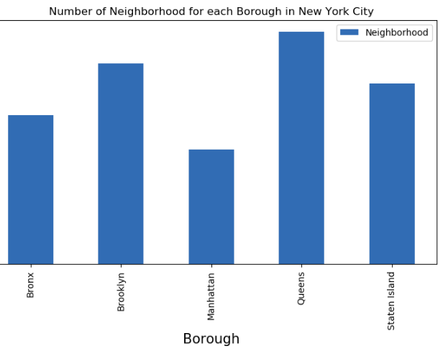
Results
We see that Queens has the highest number of Neighbourhoods

Slide 8
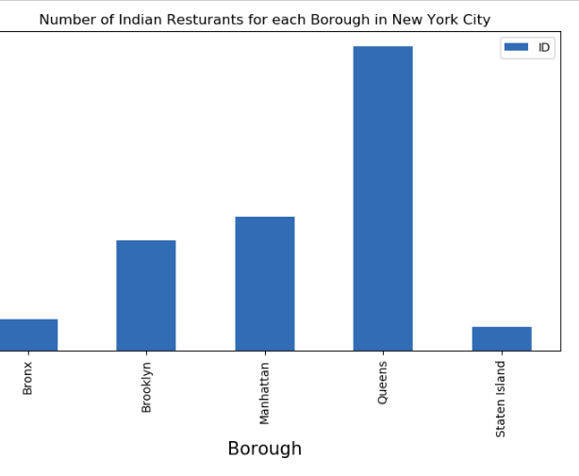
Results - continued
Also Queens has the highest number of Indian Restaurants.

Slide 9
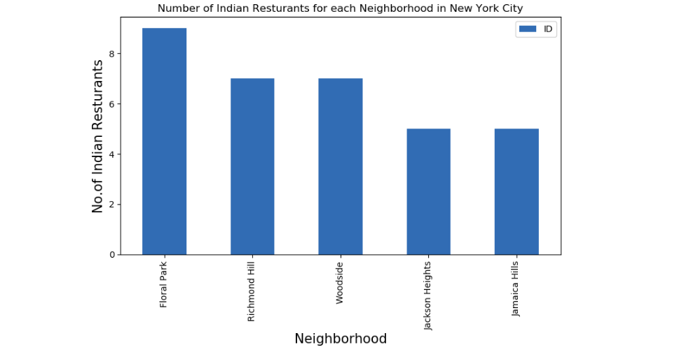
Results - continued
Floral Park in Queens has the highest number of Indian Restaurants with a total count of 9.

Slide 10
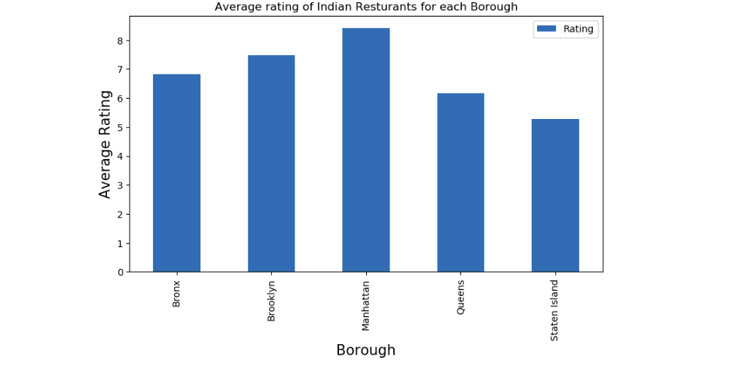
Results - continued
Manhattan has the highest average rating for Indian Restaurants

Slide 11
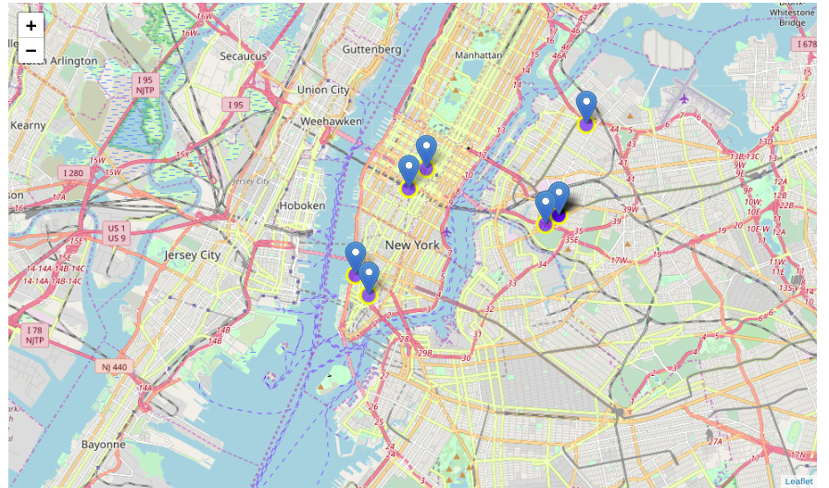
Results on Map visualisation
Best neighbourhoods in New York that has highest average rating for Indian Restaurants.

Slide 12
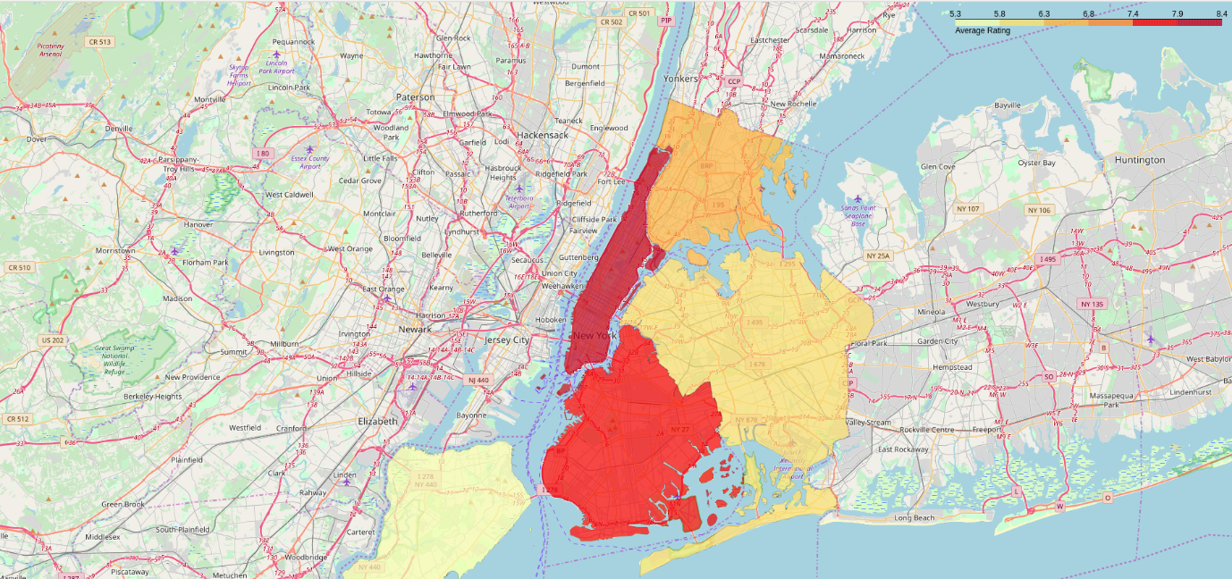
Results on Map visualisation
Borough Choropleth map based on average rating of Indian Restaurants

Slide 13
Conclusion
Astoria(Queens), Blissville(Queens), Civic Center(Manhattan) are some of the best neighbourhoods for Indian cuisine.
Manhattan have potential Indian Restaurant Market/
Staten Island ranks last in average rating of Indian Restaurants.
Manhattan is the best place to stay if you prefer Indian Cuisine.

Slide 14
Thank you

